Slide 1
Capstone Project Presentation on Seoul Bike Sharing Demand Prediction
Presented by : Priyabrata Mohanty

Slide 2
Agenda
Problem statement
Objective
Data summary
Data cleaning
Machine learning model building
Conclusion
Appendix
Data Sources
Data Assumptions

Slide 3
Problem statement
To analyze the past bike sharing booking data of Seoul and predict its demands in the upcoming days.

Slide 4
Objective
Improve our shared understanding about the market condition
Improve our shared understanding about the customer preferences
Predict the future demand of its product.
Provide early recommendation to the Seoul company.

Slide 5
Data summary
The dataset contains the information about the past Seoul bike sharing booking (Year: 2017-2018).
It contains 14 features and 8760 observations.
Important features:-
Date : year-month-day ( Bike booking dates)
Rented Bike count : Count of bikes rented at each hour
Hour : Hour of the day
Temperature : Temperature in Celsius
Holiday : Holiday/No holiday

Slide 6
Data cleaning & Processing
The columns like Temperature & Dew_point_temperature are highly corelated with each other. So removed the Dew_point_temperature
Created few more features like Date, Year, Day, Month, Weekday from the feature Date.
Removed some irrelevant unncessary features like Date, Snowfall from our dataset.

Slide 7
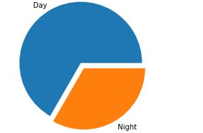
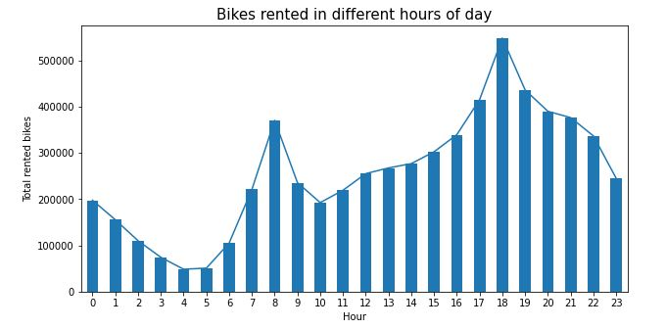
Number of Rented Bikes vs Hour
According to above graphs:
there are much more rents(Approx. 65-70%) during the day than the night.
Morning(8,9AM) & evening(6,7PM) has the highest bookings.

Slide 8
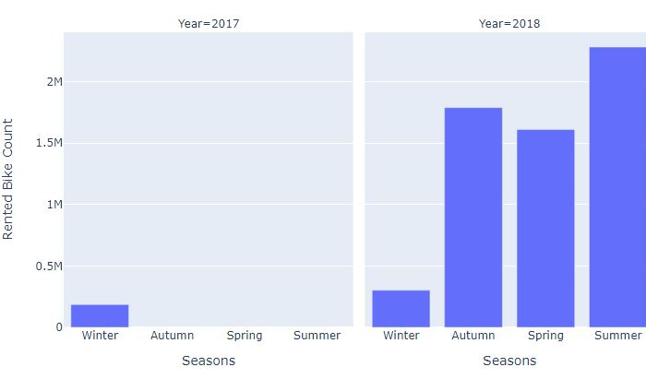
From the above bar plot
we can clearly see that:
For 2017, in Winter season the demand of rented bike was at the peak.
in case of 2018, Summer season had the highest demand.
Total Rented Bikes In Different Seasons

Slide 9
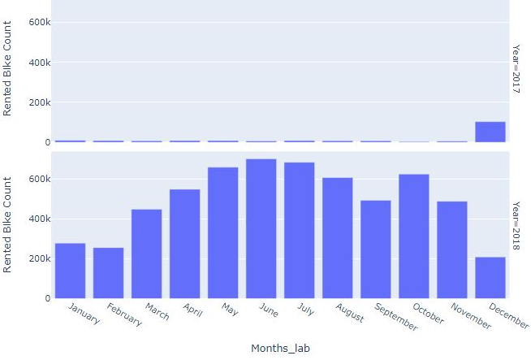
From the above bar plot
we can clearly see that:
In year 2017, month December has the highest bike bookings.
There's is a whooping increase in number of bike rents in year 2018.
Total Rented Bikes In Different Months

Slide 10
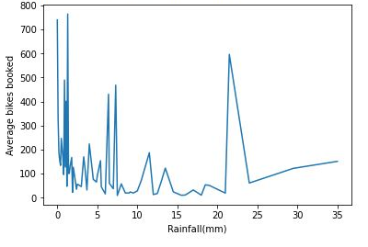
From the above bar plot
we can clearly see that:
Average number of bikes rented is high for days having very less rainfalls except the dates having 20-25mm rainfall.
Total Rented Bikes
vs Rainfall

Slide 11
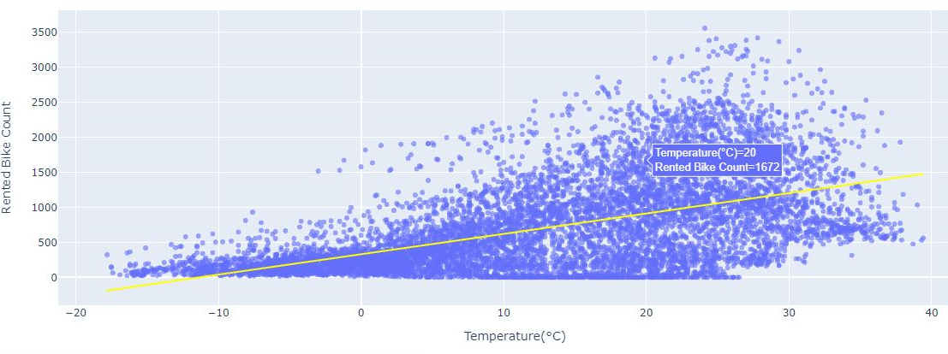
From the above bar plot
we can clearly see that:
Number of bikes
rented is highly
positively
correlated with the
Temperature.
Number Of Bikes Shared vs Temperature

Slide 12
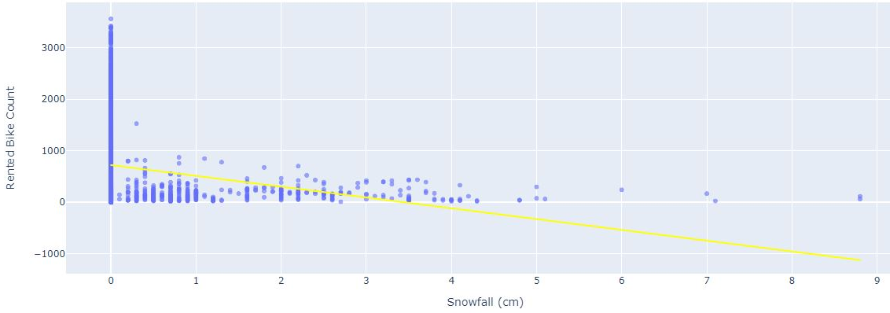
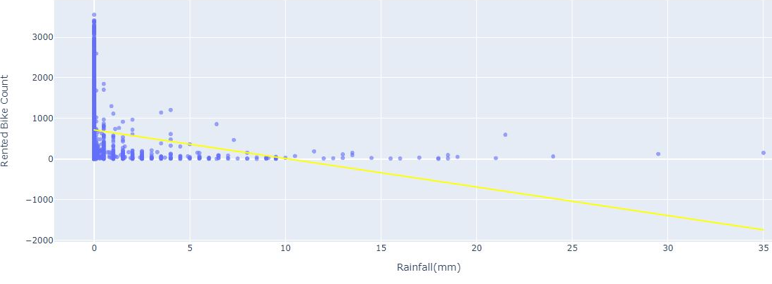
From the above bar plot
we can clearly see that:
Number of bikes
rented is highly
negatively correlated
with Snowfall &
Rainfall.

Slide 13
Machine Learning Model Insights
Linear Regression
The First of all tried with Linear Regression. The model was too simple and was not able to perform well.
The model’s R-squared score was only 0.549 on the train & test dataset.
We had to make our model more complex for better discretion. So moved to decision tree for better results.

Slide 14
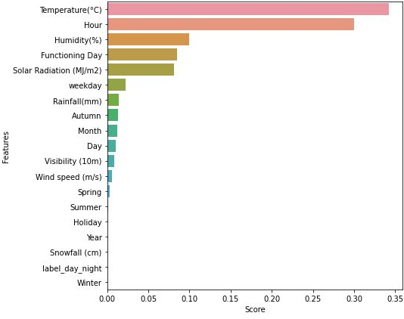
Decision Tree Regression
From the above graph
we can clearly see that, there are 3 most important
features:
Temperature
Hour
Humidity
Decision Tree scores:
R^2 score on test data: 0.913
Adjusted R^2 score: 0.912
Homogeneity score on test data: 1.0
MSE on test data: 34385.66
(Feature Importance Matrix)

Slide 15
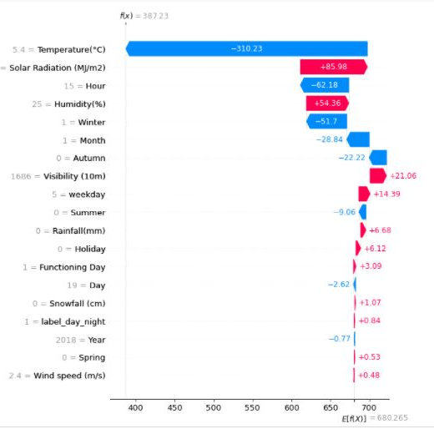
From the above bar plot
we can clearly see that:
Temperature has high impact(negative) on the rented bike booking or model’s prediction.

Slide 16
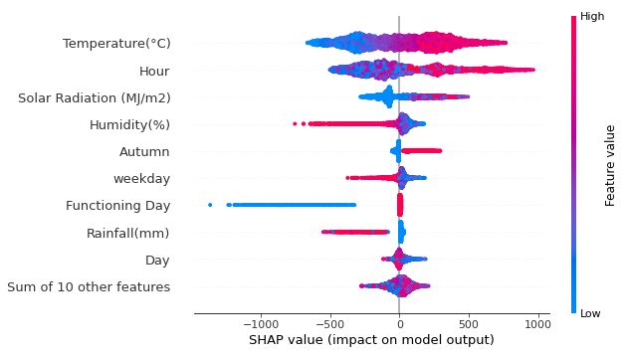
From the above bar plot
we can clearly see that:
Number of bikes
rented is highly
correlated with the
Temperature. & Hour
Hour has the overall high impact on the bike booking.
Shap Plot ( Impact On Model Output)

Slide 17
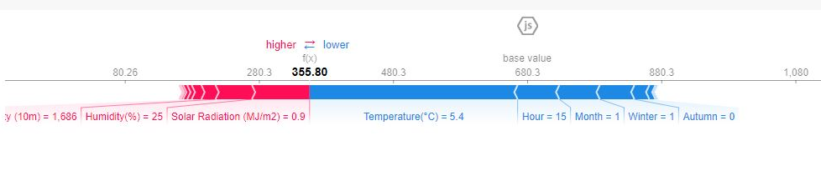
Features pushing the prediction higher are in red like Humidity & Solar Radiation.
Features which are in blue are lowering the prediction like Temperature & Hour.

Slide 18
Conclusion
The number of bikes rented in 2017 were very less as the business was started in 2017 itself & there is a drastic changes in number of bikes booked in 2018.
The total number of bikes booked is highly correlated with Temperature, Hour & Humidity.
It has highest demands during the evening time (6-7PM).
Total number of bikes booked during the day time is higher than the night.

Slide 19
Conclusion
In Summer, Autumn 2018 the total number of bikes booked is high.
For the dates having fewer rainfall, total number of bikes booked is high.
People have booked more bikes on the working days.
The Decision Tree proved to be best model for this prediction with higher accuracy rate of 91%

Slide 20
Appendix - Data sources
Here is a snapshot of data dictionary.
Rented bike information such as:
Date, Rented bike count
Weather & other information such as:
Temperature, Humidity, Rainfall, Seasons, Snowfall
We used the past dataset for the year 2017-2018

Slide 21
Appendix - Data Methodology
We conducted a thorough analysis & prediction of the Seoul bike sharing dataset. The process includes:
Data cleaning - Discard irrelevant columns and null imputation
Correlation -Finding correlation between the different parameters
EDA - Understanding data using different methods
ML Modelling – Built & tested a machine learning model to predict the upcoming booking amounts.

Slide 22
Thank You !

